Slide 1
Auto Loan Credit Score
Results and application

Slide 2
Objective
Develop a credit score model for an Auto Loan origination portfolio using machine learning methodology, in order to predict loan default in the next 12 months after evaluation

Slide 3
Background of information
Observation Window
Performance Window
Challenge
41 Variables
2 datasets in csv format
Train - 233K records
Test – 112K records
Result in credit payment after 12 months (loan default)
50% of population is No Hit – they have no credit history,
Information Available
Current credit amount, payment and usage - amounts
Detail of usage in main card and in additional accounts for people with history
Credit Bureau Score and Risk Segment
Date of birth and date of credit take
ID variables (are not useful)
Flags of different documents given (passport, vote, etc)
Source of information:
https://www.kaggle.com/mamtadhaker/lt-vehicle-loan-default-prediction/discussion

Slide 4

Methodology
Analyzing Databases and clean them: outliers and missing
Detect no info that cause bias in results (30% of information in zero)
Create new variables: sums, proportions, counts, multiplications
Variable selection: review and Reduce correlations applying hierarchical clustering to keep one variable that represent better the cluster
Review P-value to keep important variables
Apply oversampling (SMOTE) for default event but testing with the original population
Test some techniques: random forest, logistic regression
Measure results
Create a distribution table that resume results to take decisions

Slide 5
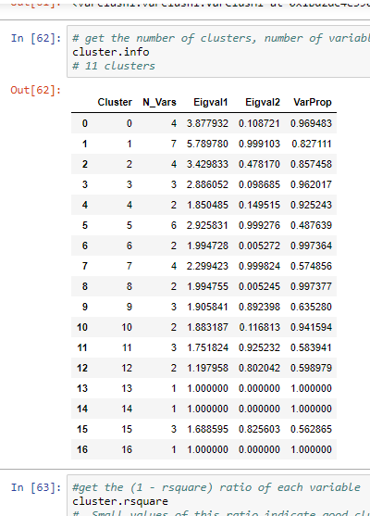
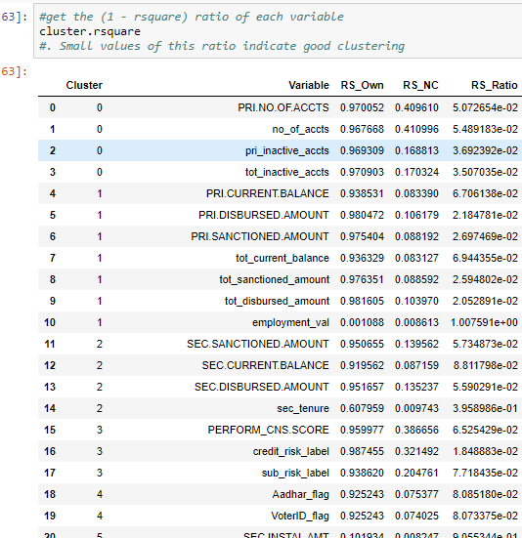
Variable Reduction with Clusters
16 clusters group all variables

Slide 6
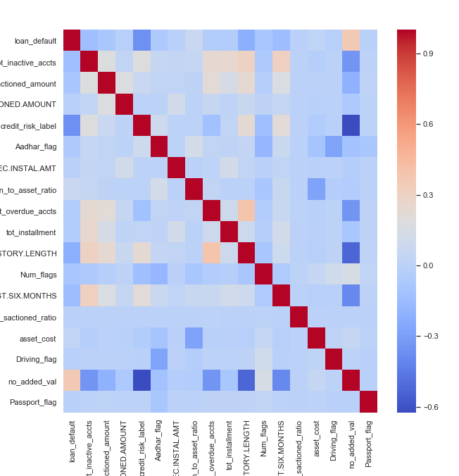
Variable Selection
From 75 we keep 17 variables to introduce in the model
Besides, 32% of credits were deleted because more than 70% in row was in zero. This caused model couldn’t improve.

Slide 7
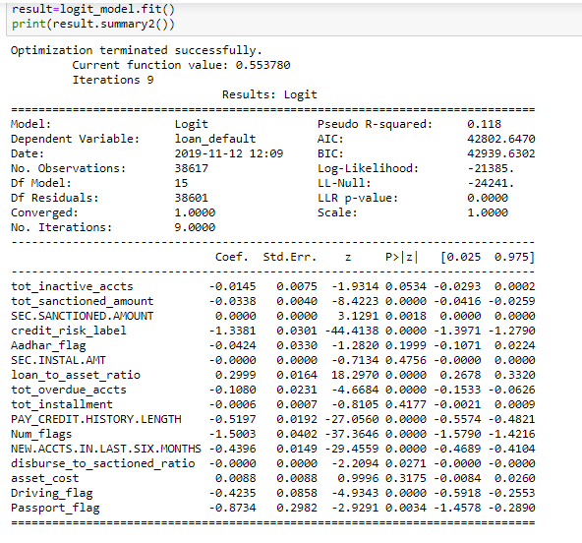
Variable Selection P-value
We applied logit model to get p-value
For a better variable selection we kept with p - value <=0.05
Final Variables: 12

Slide 8
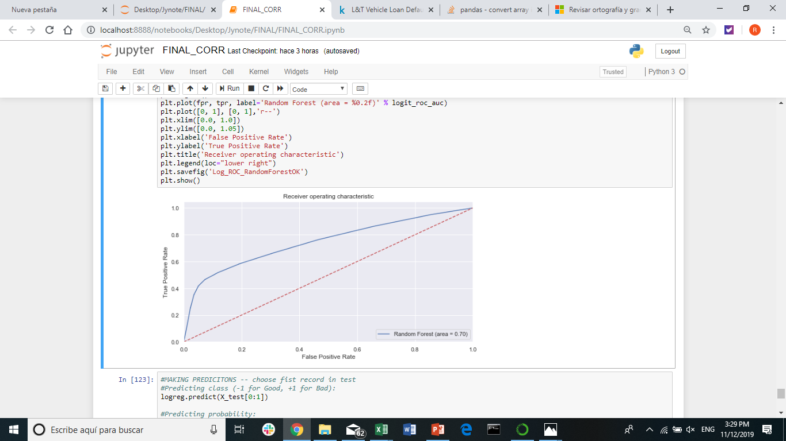
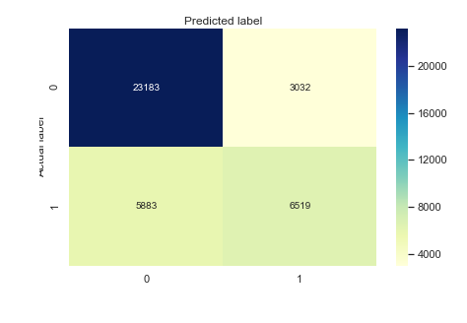
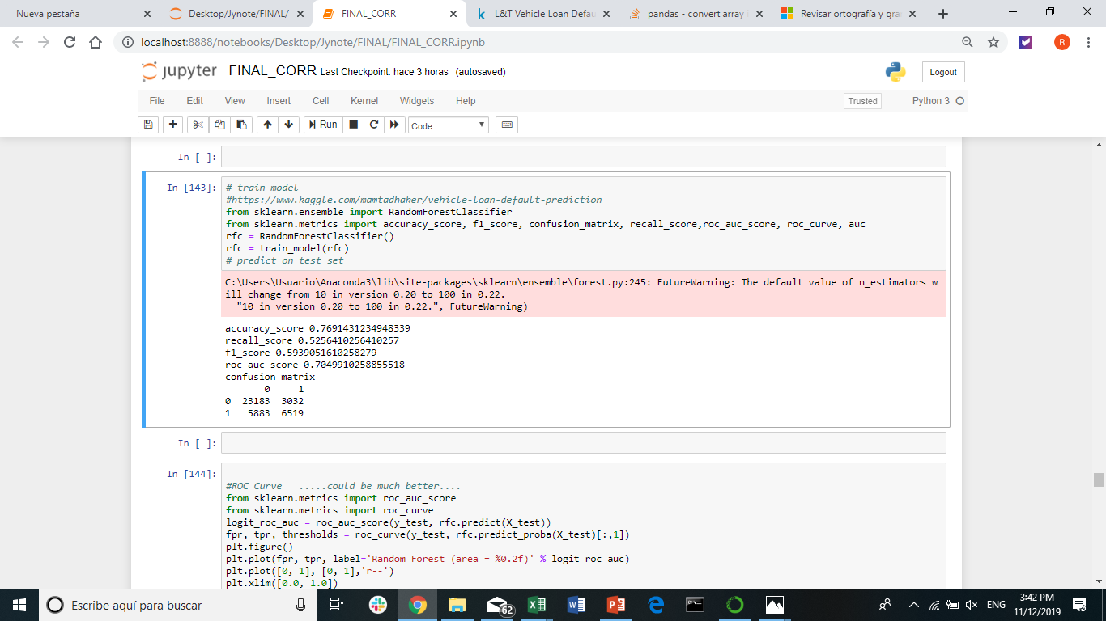
Model Performance - Random Forest
ROC curve and confusion matrix in test population
Accuracy= 76.9%
Recall Score = 52%
F1 score = 59%
ROC = 70%
54% of No Pay were well classified

Slide 9
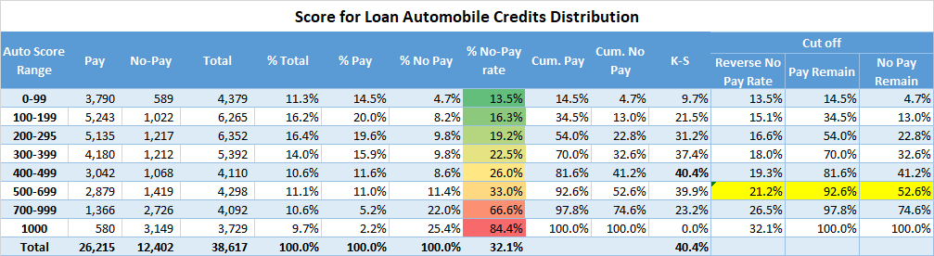
Auto Loan Score and rank ordering power
We obtained probability of default (event=1) for our test data and convert probability into a score, multiplying by 1000
Our score will be from 0 to 1000, where 0 is the probability to pay and 1000 probability of no pay (default).

Slide 10
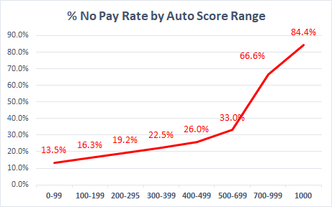
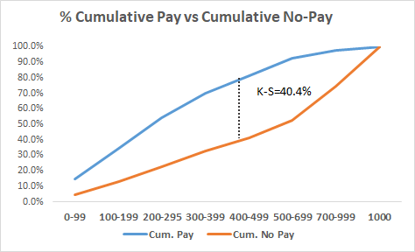
Auto Loan Score Performance in development
Score order risk to get default in a auto credit for the user

Slide 11
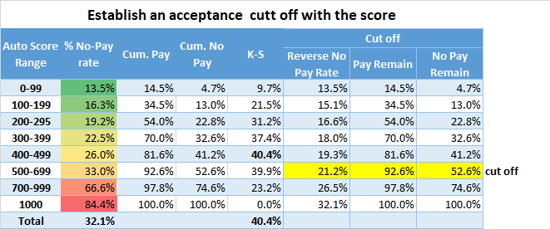
Auto Loan Score – Make practical decisions
Establish a cut off to determine which customers will be accepted to take a credit considering the
It is propose to establish a cut off in 700, so customers with a score higher o equal 700 will be rejected for an auto loan.
With this decision it is expected to reduce bad rate from 32% to 21.2%
This will impact in 7.3% of good customers which will be reject, but we will capture 48% of bad customers (no pay)

Slide 12
End

